Slide 1
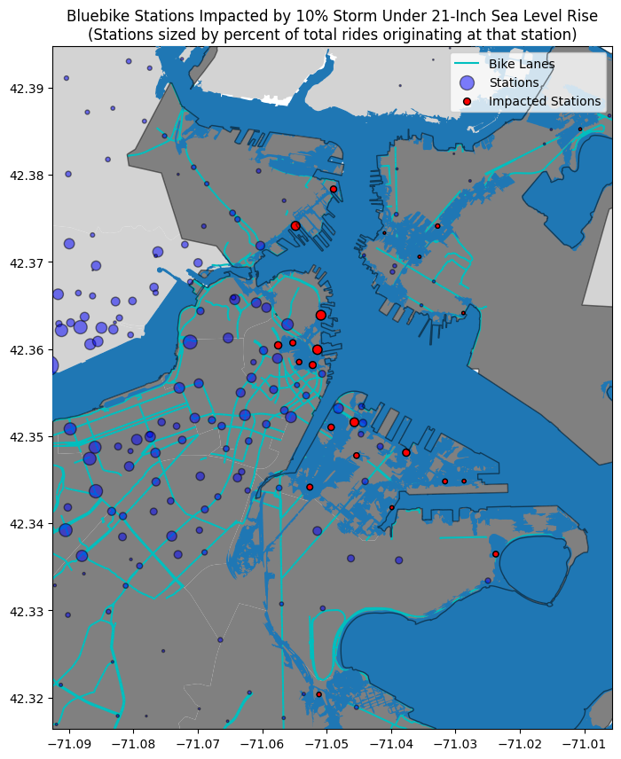
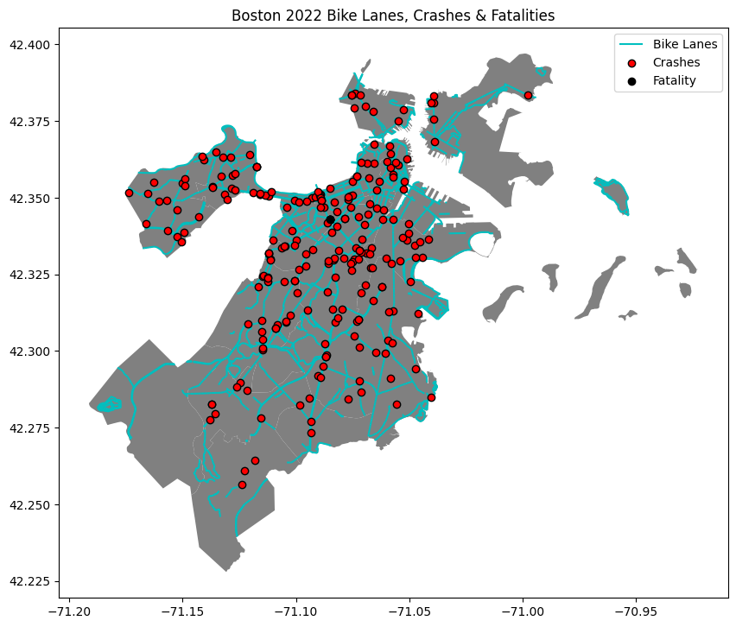
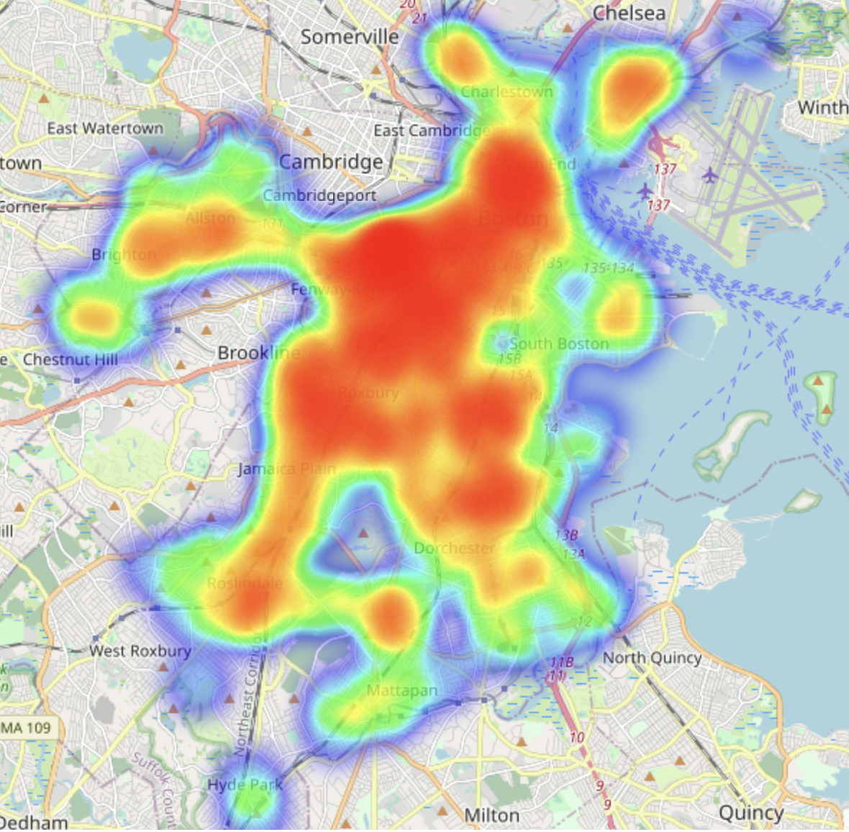
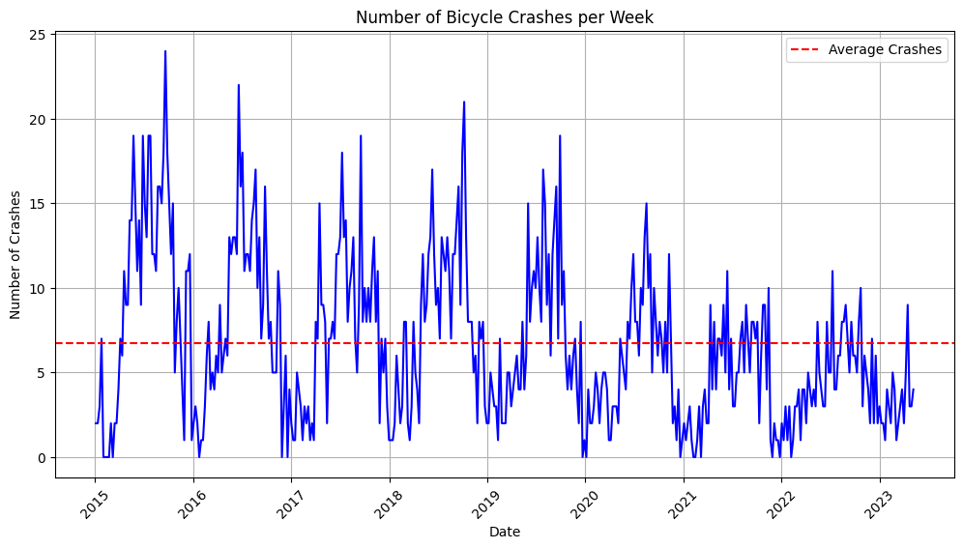
Exploring Threats to Biking in Boston: An Introductory Analysis of Bluebikes, Sea Level Rise, and Crash Incidents in Boston, MA
Zack Armand and Alex Kramer
Goal:
What are the threats to biking in Boston?
Methods:
We examined bike crashes and fatality data, sea level rise storm events, and Bluebike stations and trips to see how these data intersected in Boston.
Results:
By 2050, sea level rise of 21 inches is expected across all emissions scenarios. Under a 21-inch sea level rise scenario, a 10% storm would inundate 23 out of 251 total Bluebike stations in Boston. 175,858 out of 3,757,281
total trips originate at one of these stations, accounting for 4.7% of total trips in 2022.
Weekly counts of crashes involving a bicycle have decreased since 2015. In 2017, there were 390 crashes involving a bike; in 2022, there were 242, and 1 fatality. Crashes appear to be clustered in denser parts of the city.
There were 3,757,281 Bluebike trips in 2022, accounting for a total trip distance of 4,467,589 miles (avg. trip of 1.19 miles). Given the average emissions per mile of a car, this represents at least 1,787 metric tons of CO2 emissions avoided.
Notes:
Notes:
21 inch sea level rise: expected across all emissions scenarios by middle of the century.
Ride counts are for all municipalities, but only under the 36 inch scenario do we actually see impacts to other communities, Before that, it’s only Boston. So, ride counts are for the system as whole.
Incomplete crash data for other municipalities in the area. Focused only on Boston.
Bluebike trip distance is linear between the start and end station - so represents a minimum trip distance. We would assume that in almost all cases, actual distance travelled is longer. Also doesn’t account for circular trips, such as starting and ending at the same station.
Future ideas:
See how bike lanes impact biker safety and crash data.

